Slide 1
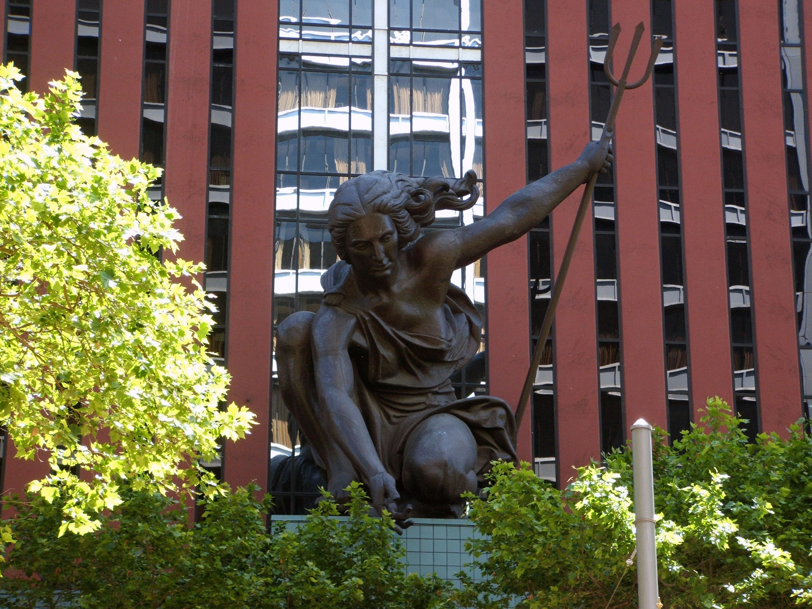
Capstone Project On Neighborhoods of New York and Toronto

Slide 2
Capstone Project – Neighborhoods of New York and Toronto
A case study is for to find out best Neighborhood and Store to start a new business

Slide 3
Business Problem :
New York and Toronto are the cities of Canada and These two cities having many neighborhoods and stores. The stores are like Restaurants, Coffee shops, Super Markets etc. From these we should find out best stores and neighborhoods wherever these stores are required and need in the neighborhoods. We should find out best neighborhood and store from these two cities using with Foursquare map.
Requirements
> Need an account in FourSquare for Locations and Stores
> Need Neighborhoods with Latitude and Longitude
> Knowledge in Data Analysis, Data Visualization,Data Processing and Machine learning algorithms with any Language Python or R.
> Need Data for Two Cities of New York and Toronto

Slide 4
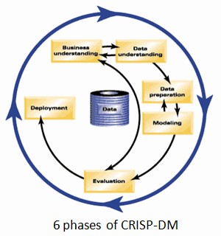
We need to follow these steps
>> Business Problem
>> Data Understanding
>> Data Preparation
>> Modeling
>> Evaluation
>> Deployment
Using with above steps, we can find out the best solution

Slide 5
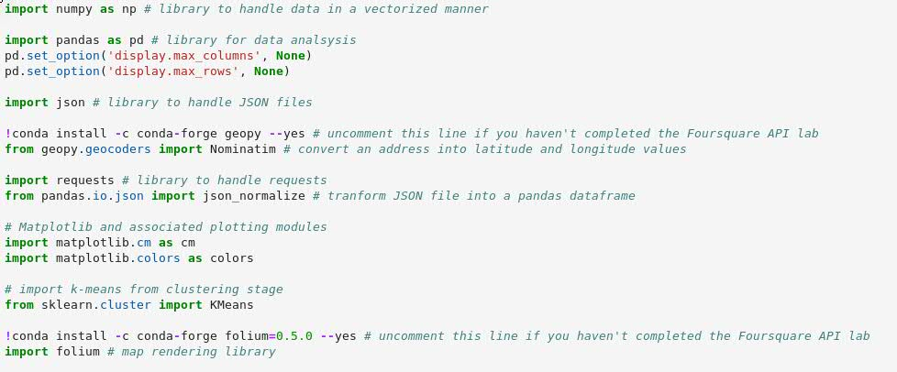
Required these Python Libraries for this Project :

Slide 6
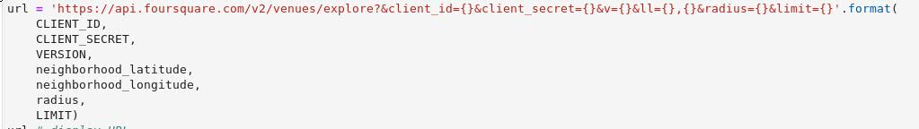
Required FourSquare Parameters :
Client Id, Client Secrete and Version of the URL.
From above URL, you have to mention Latitude and Longitude for specific city (New York or Toronto).
Go through this URL
>> https://developer.foursquare.com/

Slide 7
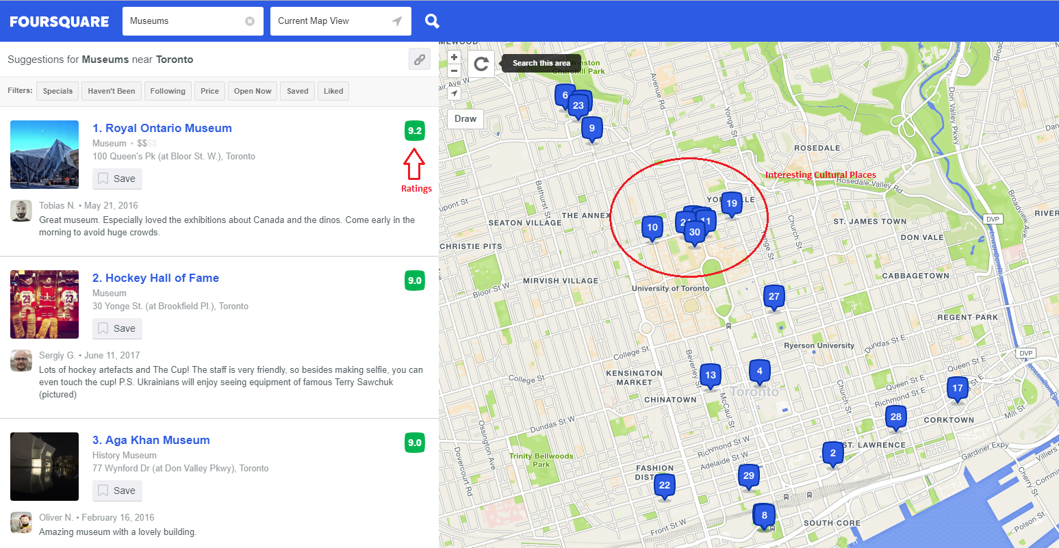
FourSquare Venues with ratings:

Slide 8
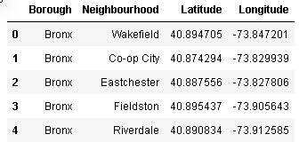
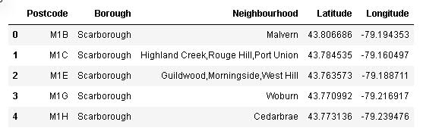
New York Data with Latitude and Longitude :
Toronto Data with Latitude and Longitude :

Slide 9
Data Understanding :
After Business problem statement, we need to understand the data like
– is this Data sufficient for the project or not ?
– What are the parameters needed ?
– We should understand whether this problem is Supervised problem or Unsupervised problem (Depending on the problem statement)
– What type of data, we are dealing with like Text, Table format, Image, audio and Video type of data ?
– what type of python libraries needed for this project ?

Slide 10
Data PreProcessing :
We should acquire the data using with Pandas Library like
>> import pandas as pd
>> pd.read_csv(“path”)
We can read the different type of the data like .CSV, .xls, .html, .text etc.
Clean the data :
* Missing values
* Wrong data
* Duplicate values
* Normalize the data
* Data Conversion

Slide 11
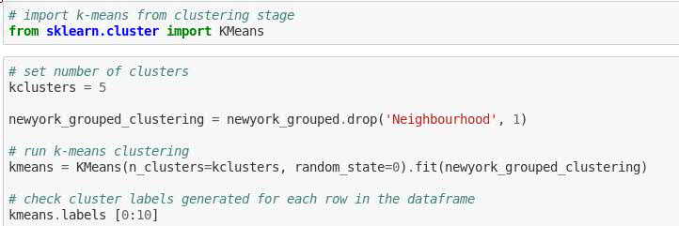
Data Modeling :
This Project is belongs to unsupervised mechanism. In this project we used K- Means clustering algorithm.

Slide 12
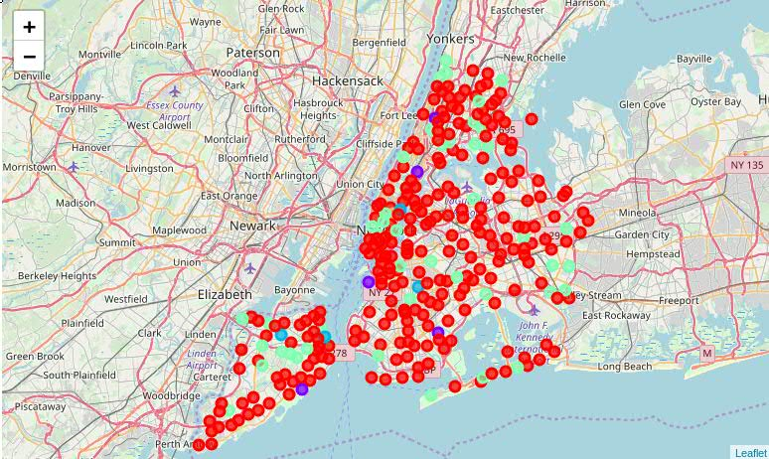
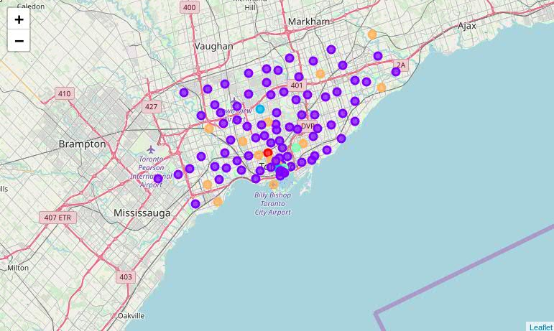
Data Visualization :
New York
Toronto

Slide 13

Data Evaluation :
We have different types of Evaluation models
>> Train_test_split
>> Crossvalidation_Score
>> Metrics (Accuracy Score)
Example:

Slide 14
Deploy the Project :
Deploying Machine Learning into production is hard. You need to:
>> Build and use the right cloud infrastructure on the right cloud provider
>> Design and implement public and internal APIs for model usage
>> Orchestrate a load of containers
>> Implement a load balancer to ensure you can scale to meet inference needs
>> Integrate with data pipelines and consistently update models

Slide 15
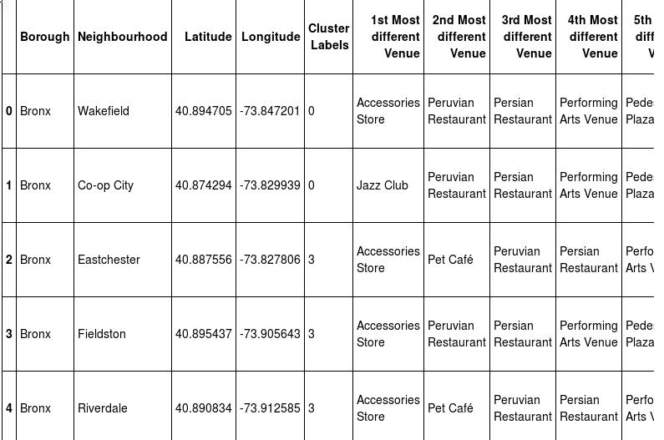
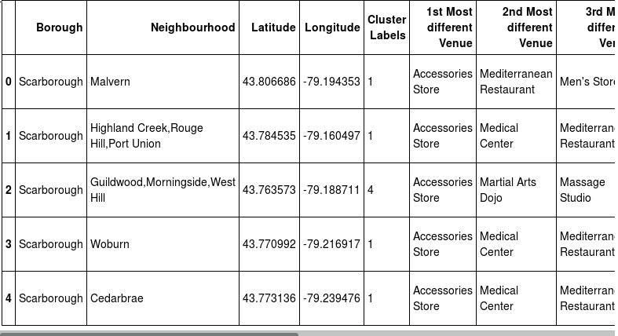
Result of New York :
Result of Toronto :

Slide 16
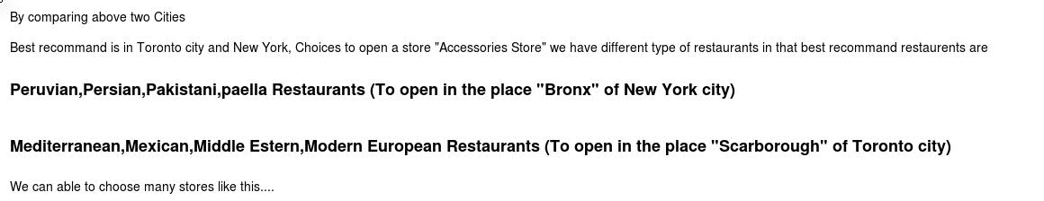
Discussion :

Slide 17
Conclusion :
The analysis of this data is rather limited because we were to use Foursquare. The basis for the ranking positions is based on this platform and are given by users directly. It’s possible to have different results if the data set were other than Foursquare, for example, official data provided by some Government division.
The Clustering function can be changed and will yield different clusters. We assumed 5, but stakeholders can change this at will.
Was interesting to note that Museums, are popular but not as much as one might think.
Given the time allowed and the limited data, this was an interesting project that could very well benefit the Tourism agencies of Toronto!

Slide 18

Thanks for taking the time to review my work!
As an appreciation gesture, here’s a cool potato for you:
Thank you...

